Slide 1
Professional Supervision
and looking after your wellbeing in the workplace

Slide 2

Super Vision

Slide 3

Climbing the body bag

Slide 4
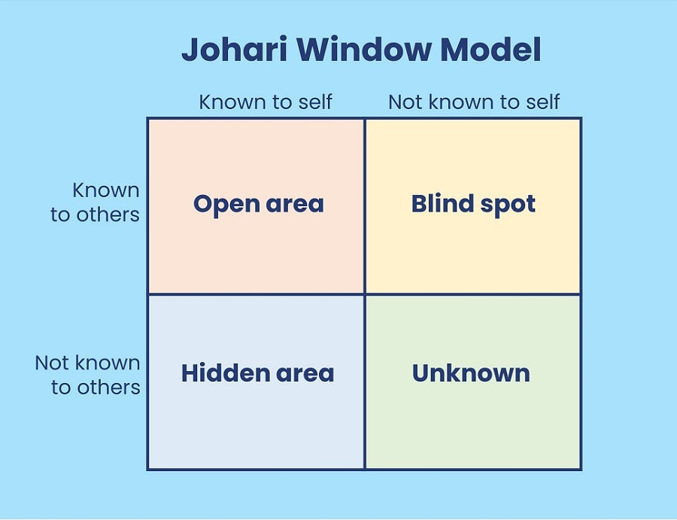
The Johari Window
The Johari window is a technique designed to help people better understand their relationship with themselves and others.
It was created by psychologists Joseph Luft and Harrington Ingham.

Slide 5
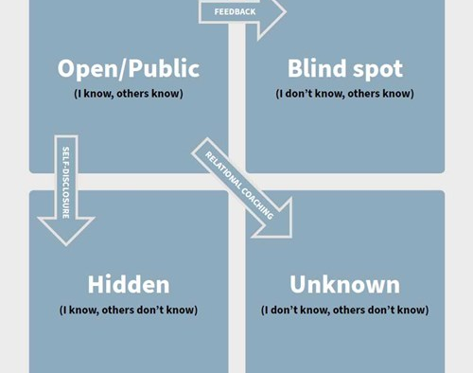
Jo-Hari window
Movement that can increase the capacity to engage in healthy relationships.

Slide 6
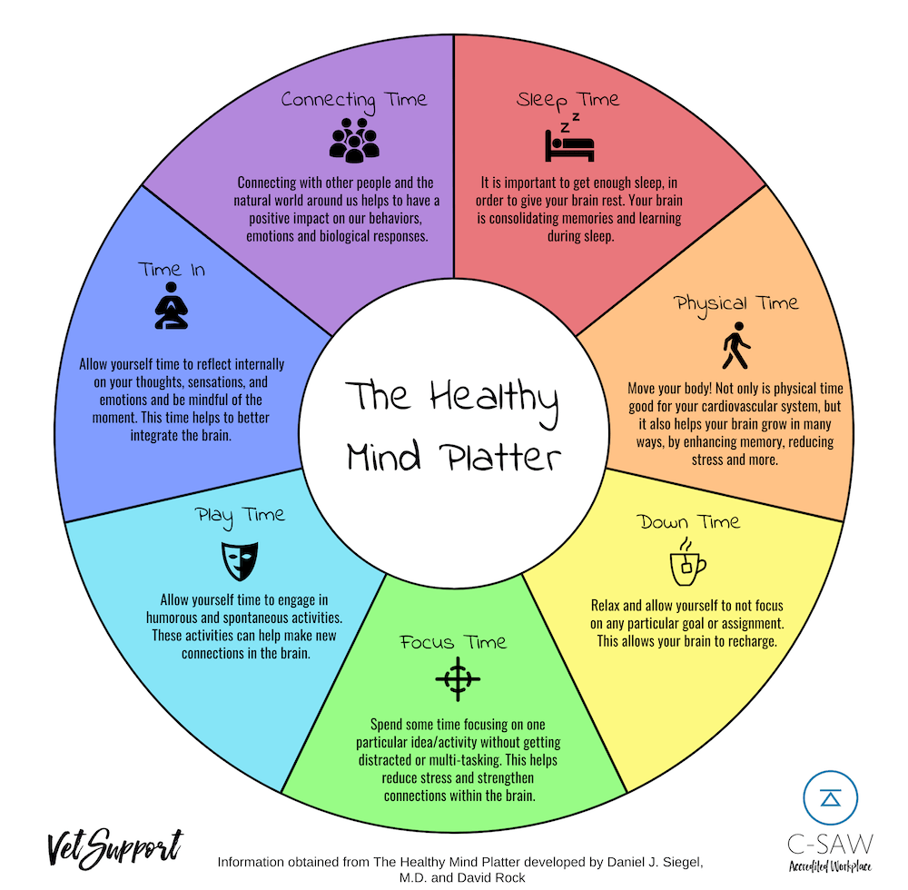
Healthy Mind Platter

Slide 7

Mikaere Greenslade
mikaeregreenslade@gmail.com

